Slide 1
Chapter 1: Interrupt/System Calls

Slide 2
Interrupt
An interrupt:
A signal from a device attached to a computer OR
From a program within the computer
That causes the main program that operates the computer (the operating system) to stop and figure out what to do next.
Interrupts can be of the following type:
Generated by Hardware (Hardware Interrupt)
Generated by Software (Software Interrupt)

Slide 3
Hardware Interrupt
Hardware interrupts are used by devices to communicate that they require attention from the operating system.
Hardware interrupts by sending a signal to CPU via a system bus.
An interrupt number references hardware interrupts.
These numbers are mapped with hardware that created the interrupt.
Enabling the system to monitor/understand:
which device created the interrupt and when it occurred.

Slide 4
Software Interrupt/ Trap
Interrupt generated by executing a instruction.
Software interrupts by a special operation called a System Call or Monitor Call.
Exp: 1. cout in C++ is a kind of interrupt because it would make a system to print something.
2. division by zero

Slide 5
I/O Interrupt
Once the I/O is started, 2 kind of interrupts may arise:
Synchronous interrupt (I/O): The control is transferred to the user process when I/O completes.
Asynchronous interrupt (I/O): Returns control to user process without waiting for I/O to complete.

Slide 6
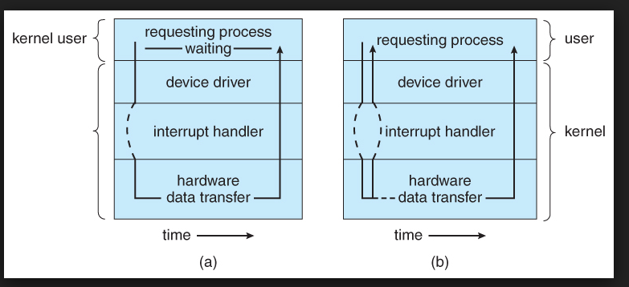
(a) Synchronous (b) Asynchronous

Slide 7
System Calls
Allow user-level processes to request services of the operating system.
It provides a way in which program talks to the operating system.
Why system calls are required?
It is a request to the operating system to perform some activity.
It is a call to the kernel in order to execute a specific function that controls a device or executes a instruction.
A system call looks like a procedure call

Slide 8
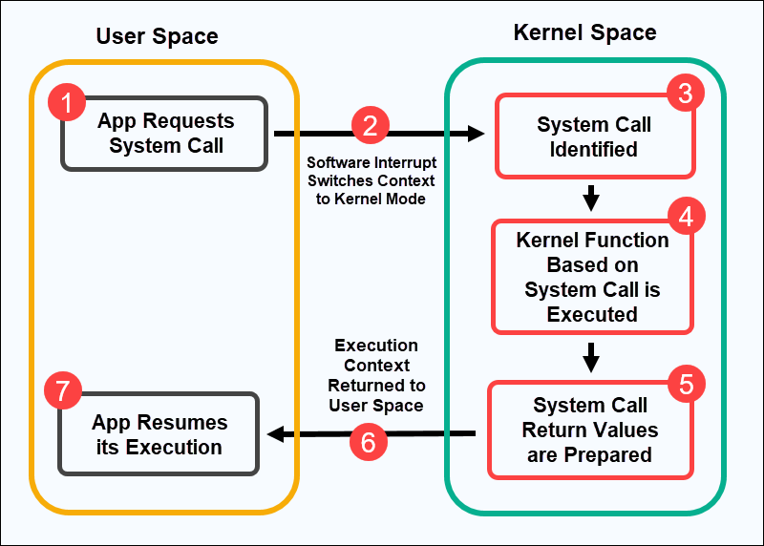
Working of System Call

Slide 9
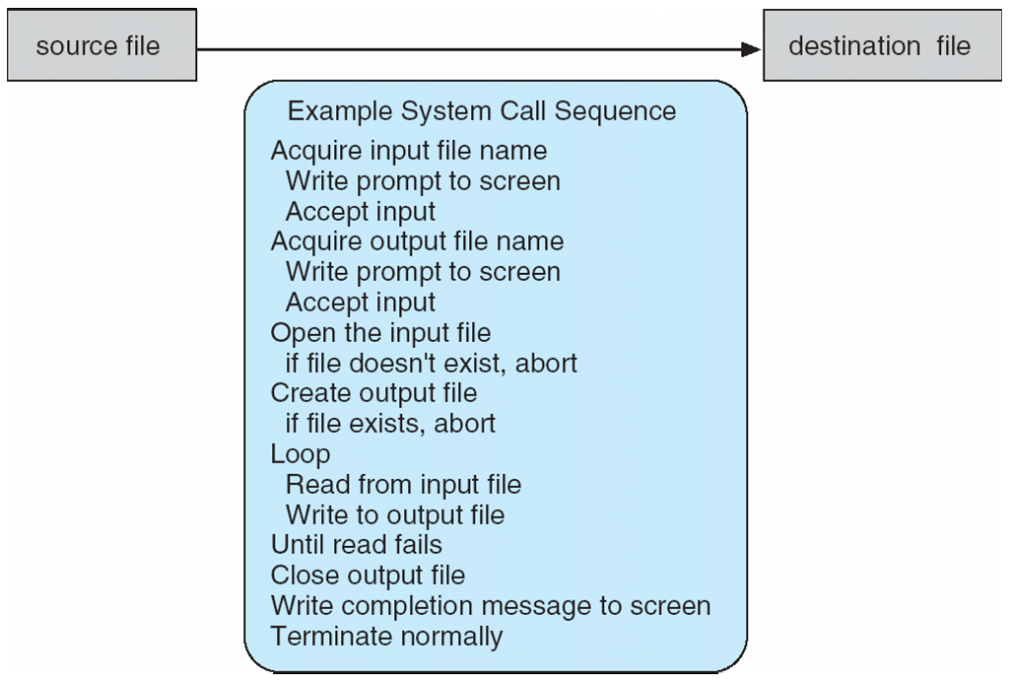
Example of System Calls
System call sequence to copy the contents of one file to another file

Slide 10
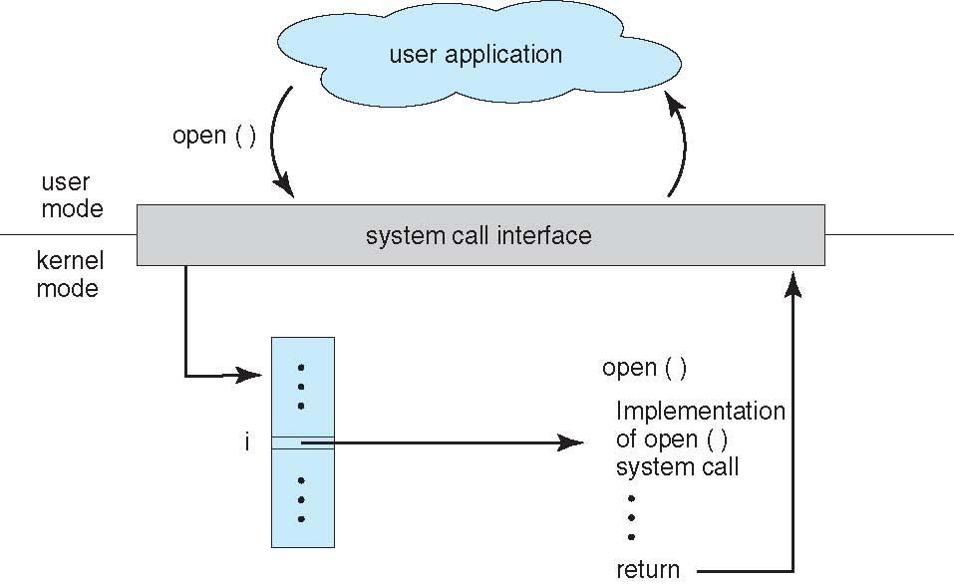

API – System Call – OS Relationship

Slide 11
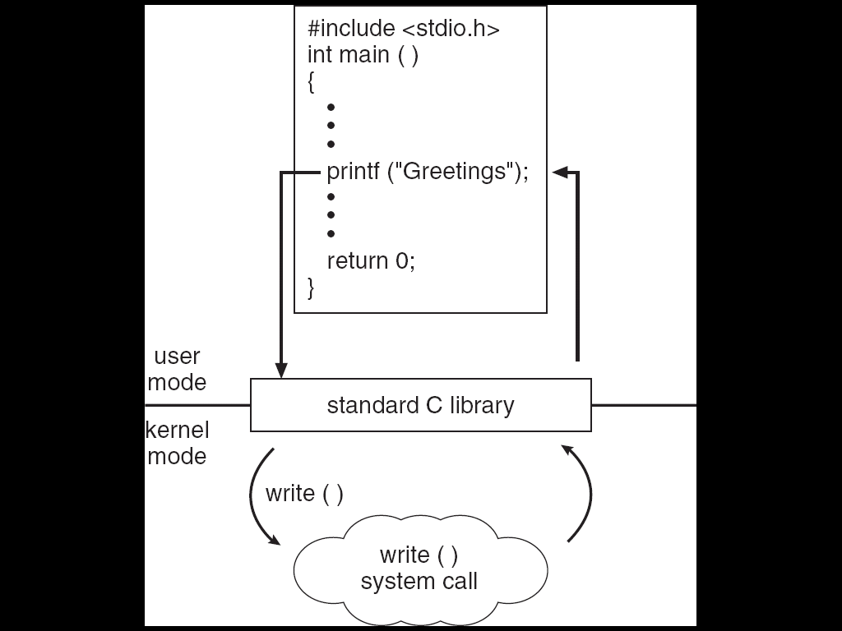
Standard C Library Example
C program invoking printf() library call, which calls write() system call

Slide 12
System Call Parameter Passing
Passing Parameters to System Calls:
Information required for a system call vary according to OS and call.
Three general methods used to pass parameters to the OS
1. Pass the parameters in registers
When parameters are < 6.
2. Parameters stored in a block, or table, in memory, and address of block passed as a parameter in a register. (6 or more)
This approach taken by Linux and Solaris
3. Parameters placed, or pushed, onto the stack by the program and popped off the stack by the operating system.

Slide 13
Types of System Calls 5 Categories
Process Control
end, abort
load, execute
create process, terminate process
get process attributes, set process attributes
wait for time
wait event, signal event
allocate and free memory
File Management
create file, delete file
open, close file
read, write, reposition
get and set file attributes

Slide 14
Types of System Calls (Cont.)
Device Management
request device, release device
read, write, reposition
get device attributes, set device attributes
logically attach or detach devices
Information Maintenance
get time or date, set time or date
get system data, set system data
get and set process, file, or device attributes
Communications
create, delete communication connection
send, receive messages
transfer status information
attach and detach remote devices

Slide 15
System Call Implementation
HLL provide System Call Interface
Program makes API Call (application programming interface)
API trapped by RTL (run time library)
RTL places system calls in register
Places parameters in specific locations and Completes System Call

Slide 16
When a system executes a C program, CPU runs in ____ mode.
a) user
b) kernel
c) supervisory
d) system
Notes:
Kernel

Slide 17
When a user initiates to execute a C program, CPU runs in ____ mode.
a) user
b) kernel
c) supervisory
d) system
Notes:
User

Slide 18
Which program signal for the occurrence of an event either from the hardware or the software?
a) Bootstrap program
b) Interrupt
c) Disk Controller
d) CPU

Slide 19
MCQ
What is the objective of multiprogramming?
A Have some process running at all times
B Have multiple programs waiting in a queue ready to run
C To minimize CPU utilization
D None of the mentioned
Notes:
A

Slide 20
MCQ
In a multiprogramming environment .....
A the processor executes more than one process at a time
B the programs are developed by more than one person
C more than one process resides in the memory
D a single user can execute many programs at the same time
Notes:
C

Slide 21

Practice MCQ:
Link: https://forms.gle/PY2o8vRLKfeUU6qq7
QR Code:

Slide 22
Next Topic!!

